Slide 1


Slide 2


Slide 7

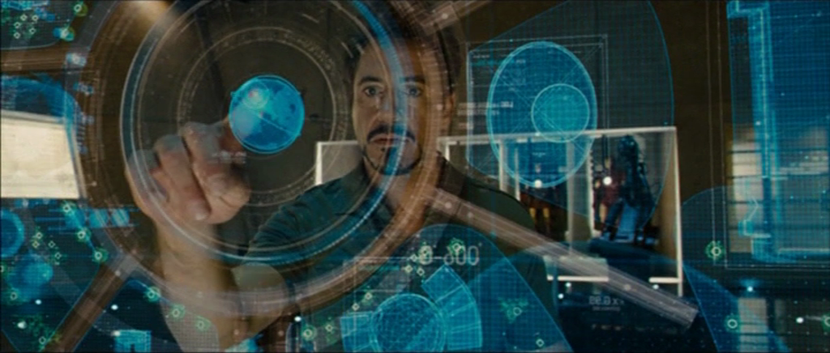
The Future of Presentations

